Slide 1
Chapter
6
Foundations of Business Intelligence: Databases and Information Management
Notes:
There are three video cases available for this chapter:
Case 1: Dubuque Uses Cloud Computing and Sensors to Build a Smarter City
Case 2: Brooks Brothers Closes In on OmniChannel Retail
Case 3: Maruti Suzuki Business Intelligence and Enterprise Databases

Slide 2
Essentials of Management Information Systems
Chapter 6 Foundations of Business Intelligence: Databases and
Information Management
Student Learning Objectives
What is a database and how does a relational database organize data?
What are the principles of a database management system?
Notes:
Ask students to make a list with you of all the databases they use or interact with in their lives. The idea here is to make students aware of the ubiquity and importance of record keeping systems (databases). Databases are at the very heart of the MIS profession.

Slide 3
Essentials of Management Information Systems
Chapter 6 Foundations of Business Intelligence: Databases and
Information Management
Student Learning Objectives
What are the principal tools and technologies for accessing information from databases to improve business performance and decision making?
Why are information policy, data administration, and data quality assurance essential for managing the firm’s data resources?
Notes:
Ask students if they have had any experience with errors in a database? A mistaken identity, a wrong address, an incorrect balance on a statement. Why are data errors important for a business? For individuals?

Slide 4
Essentials of Management Information Systems
Chapter 6 Foundations of Business Intelligence: Databases and
Information Management
Student Learning Objectives
Learning Tracks
Database Design, Normalization, and Entity-Relationship Diagramming
Introduction to SQL
Hierarchical and Network Data Models
Video Cases
Case 1: Dubuque Uses Cloud Computing and Sensors to Build a Smarter City
Case 2: : Brooks Brothers Closes In on OmniChannel Retail
Case 3: Maruti Suzuki Business Intelligence and Enterprise Databases

Slide 5
Essentials of Management Information Systems
Chapter 6 Foundations of Business Intelligence: Databases and
Information Management
BAE Systems
Problem:
  Legacy information systems impeding aircraft part of business
  Distributed nature of BAE’s design and manufacturing make storing and analyzing accurate sets of data challenging
  Accessing data from many systems a complex task
Solution:
  Single repository for CAD/CAM data
Notes:
In an age of non-organic corporate growth where companies grow by acquiring other companies, business firms quickly become a collection of hundreds of databases, email systems, personnel systems, accounting systems, and manufacturing systems, none of which can communicate with one another. Even if firms grow organically without acquisitions it is common for separate departments and divisions to have their own systems and databases. Firms in this case suffer the same result: the firm becomes a collection of systems that cannot share information. This creates a demand for powerful, enterprise wide or firm wide databases that can bring order to the chaos.

Slide 6
Essentials of Management Information Systems
Chapter 6 Foundations of Business Intelligence: Databases and
Information Management
BAE Systems
Siemen’s Teamcenter and Dassault Systemes’ CATIA together have given BAE powerful integrated data management tools
Demonstrates IT’s role in successful data management
Illustrates digital technology’s ability to lower costs while improving performance

Slide 7
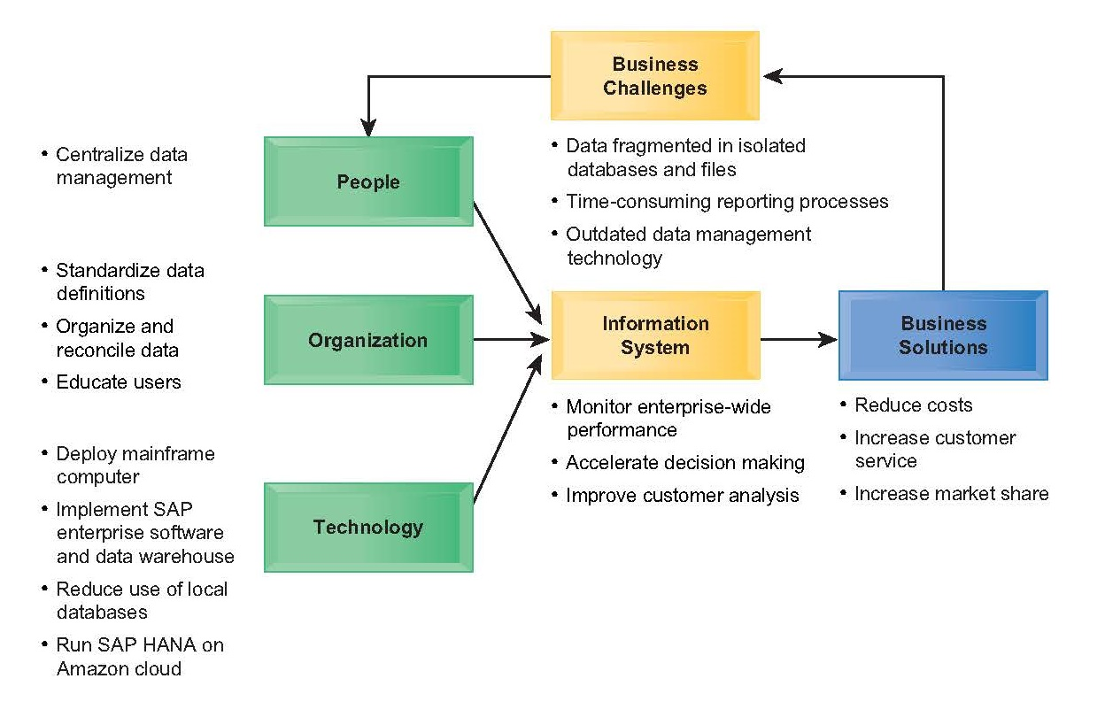
Essentials of Management Information Systems
Chapter 6 Foundations of Business Intelligence: Databases and
Information Management
BAE Systems

Slide 8
Essentials of Management Information Systems
Chapter 6 Foundations of Business Intelligence: Databases and
Information Management
What is a database and how does a relational database organize data?
Database:
  Collection of related files containing records on people, places, or things.
  Prior to digital databases, business used file cabinets with paper files.
Entity:
  Generalized category representing person, place, thing on which we store and maintain information
  E.g., SUPPLIER, PART
Attributes:
  Specific characteristics of each entity:
    SUPPLIER name, address
    PART description, unit price, supplier
Notes:
Ask students to identify the entities and attributes in a college. Entities might be students, professors, classrooms, buildings, administrators, and so on. Attributes might be name, address, position, classes taught, and so forth.

Slide 9
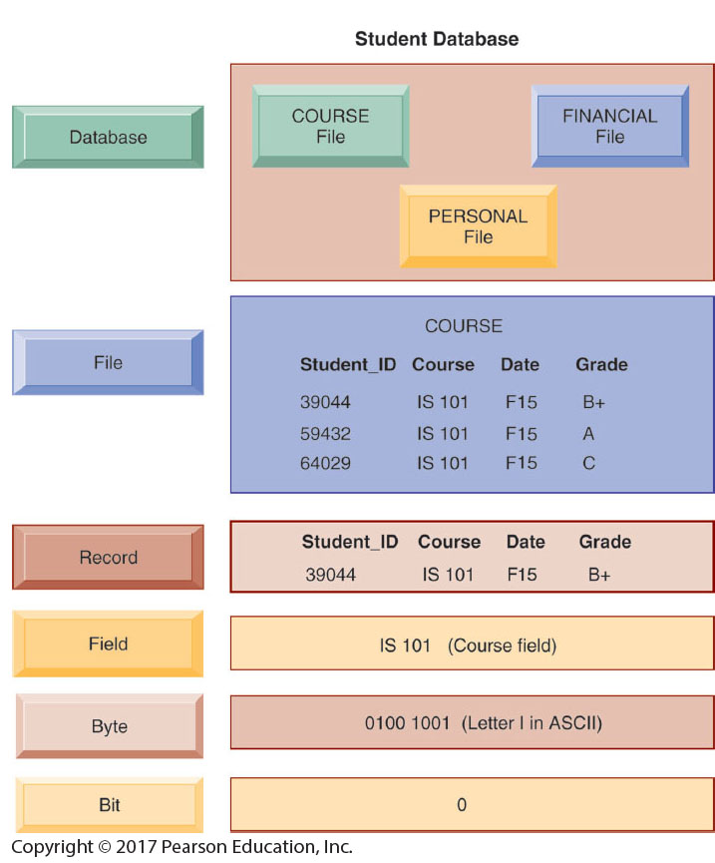
Essentials of Management Information Systems
Chapter 6 Foundations of Business Intelligence: Databases and
Information Management
What is a database and how does a relational database organize data?
The Data Hierarchy
A computer system organizes
data in a hierarchy
that starts with the bit,
which represents either a 0
or a 1. Bits can be grouped
to form a byte to represent
one character, number,
or symbol. Bytes can be
grouped to form a field,
and related fields can be
grouped to form a record.
Related records can be collected
to form a file, and
related files can be organized
into a database.
Figure 6.1
Notes:
Ask students to identify the entities and attributes in a college. Entities might be students, professors, classrooms, buildings, administrators, and so on. Attributes might be name, address, position, classes taught, and so forth.

Slide 10
Essentials of Management Information Systems
Chapter 6 Foundations of Business Intelligence: Databases and
Information Management
What is a database and how does a relational database organize data?
Relational database:
  Organize data into two-dimensional tables (relations) with columns and rows.
  One table for each entity:
    E.g., (CUSTOMER, SUPPLIER, PART, SALES)
  Fields (columns) store data representing an attribute.
  Rows store data for separate records, or tuples.
  Key field: uniquely identifies each record.
  Primary key:
    One field in each table
    Cannot be duplicated
    Provides unique identifier for all information in any row

Slide 11
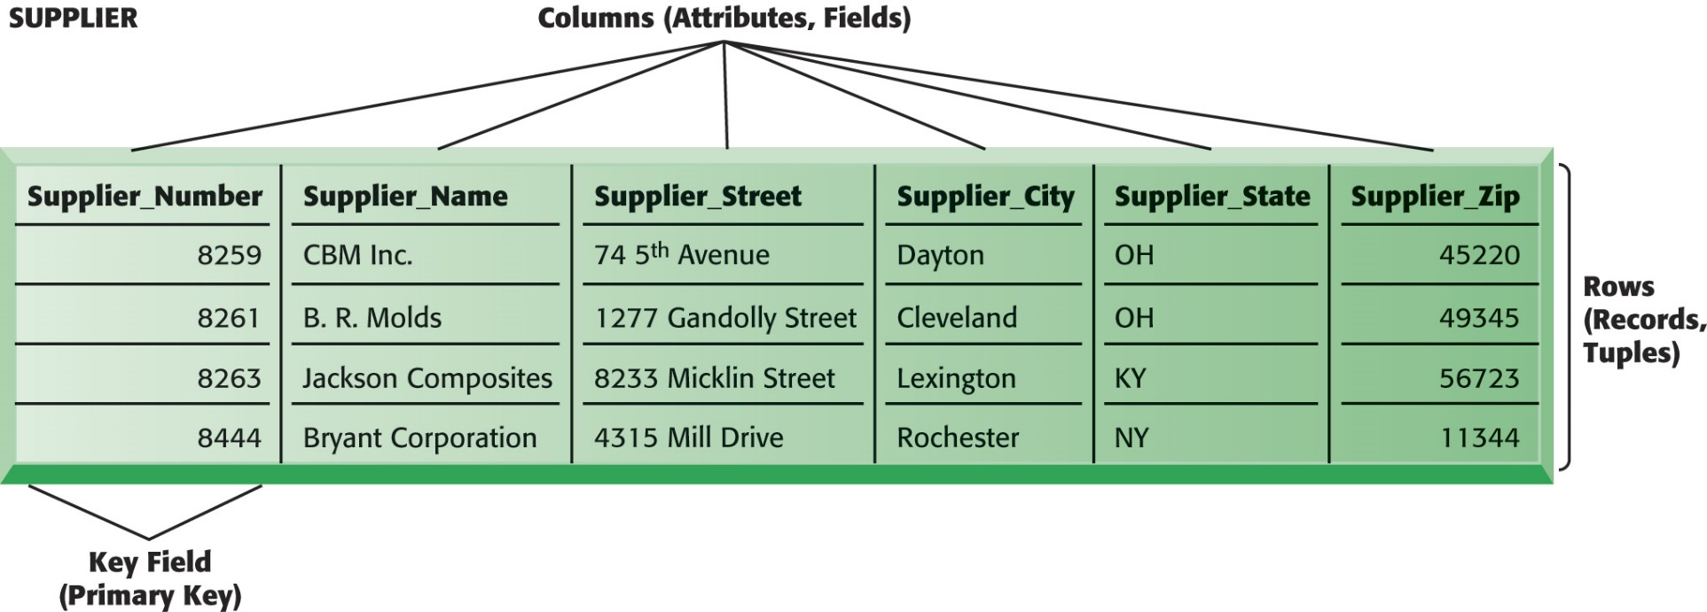
Essentials of Management Information Systems
Chapter 6 Foundations of Business Intelligence: Databases and
Information Management
What is a database and how does a relational database organize data?
A Relational Database Table
A relational database organizes data in the form of two-dimensional tables. Illustrated here is a table for the entity SUPPLIER showing how it represents the entity and its attributes. Supplier_Number is the key field.
Figure 6.2
Notes:
The graphic on this slide and the next illustrates two tables in a relational DBMS. Ask students what the entity on this slide and the next are.
The key field in the Supplier table is the Supplier number. What is the purpose of the key field?

Slide 12
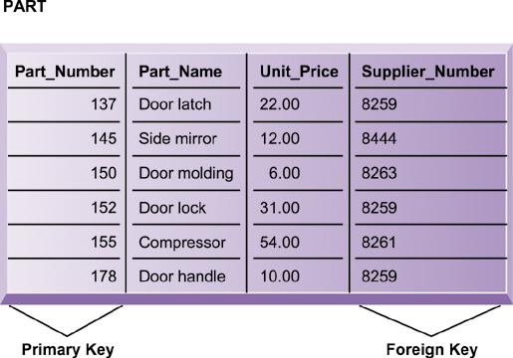
Essentials of Management Information Systems
Chapter 6 Foundations of Business Intelligence: Databases and
Information Management
What is a database and how does a relational database organize data?
The PART Table
Data for the entity PART have their own separate table. Part_Number is the primary key and Supplier_Number is the foreign key, enabling users to find related information from the SUPPLIER table about the supplier for each part.
Figure 6.3
Notes:
This slide shows the second part of the graphic on the previous slide. Notice that the foreign key in this table is the primary key in the Suppliers table. What is the purpose of the foreign key. Can multiple records have the same foreign key?

Slide 13
Essentials of Management Information Systems
Chapter 6 Foundations of Business Intelligence: Databases and
Information Management
The Database Approach to Data Management
Establishing relationships
  Entity-relationship diagram
    Used to clarify table relationships in a relational database
  Relational database tables may have:
    One-to-one relationship
    One-to-many relationship
    Many-to-many relationship
      Requires “join table” or intersection relation that links the two tables to join information

Slide 14

Essentials of Management Information Systems
Chapter 6 Foundations of Business Intelligence: Databases and
Information Management
What is a database and how does a relational database organize data?
A Simple Entity-Relationship Diagram
This diagram shows the relationship between the entities SUPPLIER and PART.
Figure 6.4

Slide 15
Essentials of Management Information Systems
Chapter 6 Foundations of Business Intelligence: Databases and
Information Management
The Database Approach to Data Management
Normalization
  Process of streamlining complex groups of data to:
    Minimize redundant data elements.
    Minimize awkward many-to-many relationships.
    Increase stability and flexibility.
Referential integrity rules
  Used by relational databases to ensure that relationships between coupled tables remain consistent.
  E.g., when one table has a foreign key that points to another table, you may not add a record to the table with foreign key unless there is a corresponding record in the linked table.
Notes:
This slide describes activities involved in designing a database. To create an efficient database, you must know what the relationships are among the various data elements, the types of data that will be stored, and how the organization will need to manage the data. Note that the conceptual database design is concerned with how the data elements will be grouped, what data in what tables will make the most efficient organizations.

Slide 16
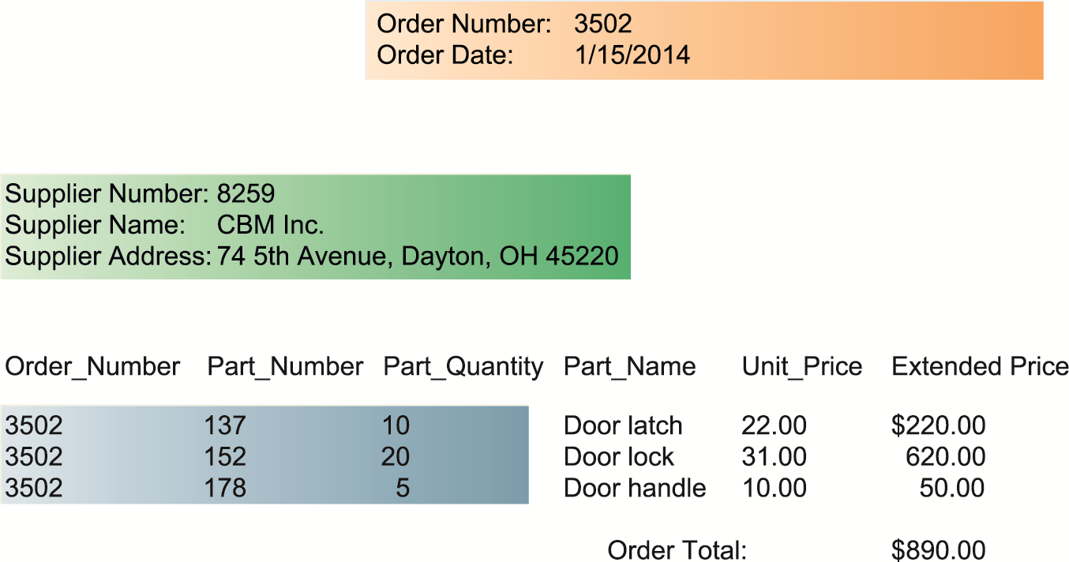
Essentials of Management Information Systems
Chapter 6 Foundations of Business Intelligence: Databases and
Information Management
What is a database and how does a relational database organize data?
Sample Order Report
The shaded areas show which data came from the SUPPLIER, LINE_ITEM, and ORDER tables. The database does not maintain data on Extended Price or Order Total because they can be derived from other data in the tables.
Figure 6.5

Slide 17
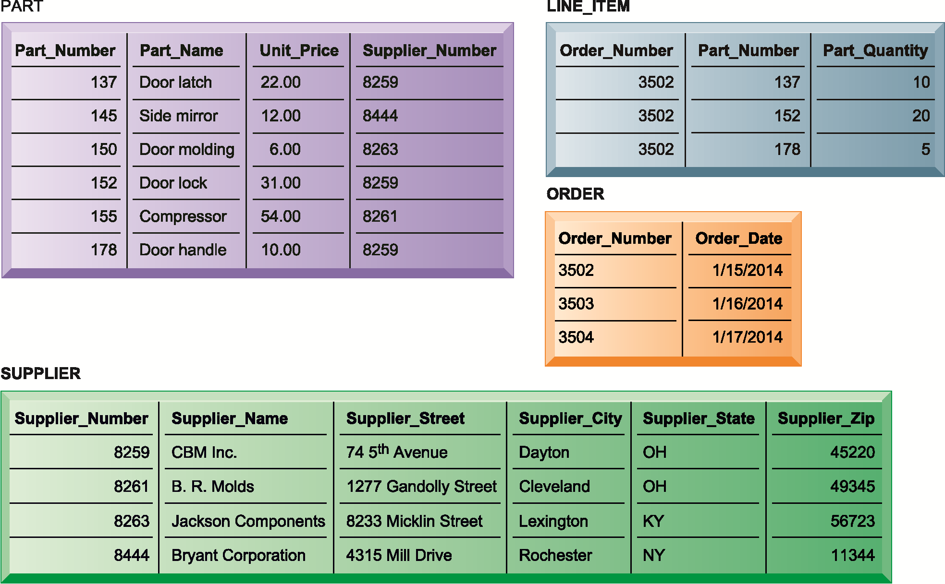
Essentials of Management Information Systems
Chapter 6 Foundations of Business Intelligence: Databases and
Information Management
What is a database and how does a relational database organize data?
The Final Database Design with Sample Records
Figure 6.6
The final design of the database for suppliers, parts, and orders has four tables. The LINE_ITEM table is a join table that eliminates the many-to-many relationship between ORDER and PART.

Slide 18
Essentials of Management Information Systems
Chapter 6 Foundations of Business Intelligence: Databases and
Information Management
What is a database and how does a relational database organize data?
Entity-Relationship Diagram for the Database
with Four Tables
This diagram shows the relationship between the entities SUPPLIER, ART, LINE_ITEM, and ORDER.
Figure 6.7
Notes:
This graphic shows an example of an entity relationship diagram. It shows that one ORDER can contain many LINE_ITEMs. (A PART can be ordered many times and appear many times as a line item in a single order.) Each LINE ITEM can contain only one PART. Each PART can have only one SUPPLIER, but many PARTs can be provided by the same SUPPLIER.

Slide 19
Essentials of Management Information Systems
Chapter 6 Foundations of Business Intelligence: Databases and
Information Management
What are the principles of a database management system?
DBMS
Specific type of software for creating, storing, organizing, and accessing data from a database
Separates the logical and physical views of the data
Logical view: how end users view data
Physical view: how data are actually structured and organized
Examples of DBMS: Microsoft Access, DB2, Oracle Database, Microsoft SQL Server, MySQL,
Notes:
One of the most popular open source databases (purchased by SUN Computer but now owned by Oracle) is MySQL. Go to http://www.mysql.com/customers/ in class for some illustrations of companies that use MySQL. This database management system is not as sophisticated as high end enterprise database systems but still quite sufficient for many businesses.

Slide 20
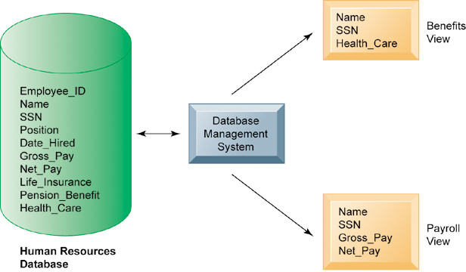
Essentials of Management Information Systems
Chapter 6 Foundations of Business Intelligence: Databases and
Information Management
What are the principles of a database management system?
Human Resources Database with Multiple Views
Figure 6.8
A single human resources database provides many different views of data, depending on the information requirements of the user. Illustrated here are two possible views, one of interest to a benefits specialist and one of interest to a member of the company’s payroll department.
Notes:
This graphic illustrates what is meant by providing different logical views of data. The orange rectangles represent two different views in an HR database, one for reviewing employee benefits, the other for accessing payroll records. The students can think of the green cylinder as the physical view, which shows how the data are actually organized and stored on the physical media. The physical data do not change, but a DBMS can create many different logical views to suit different needs of users.

Slide 21
Essentials of Management Information Systems
Chapter 6 Foundations of Business Intelligence: Databases and
Information Management
What are the principles of a database management system?
Operations of a Relational DBMS
Select:
  Creates a subset of all records meeting stated criteria
Join:
  Combines relational tables to present the server with more information than is available from individual tables
Project:
  Creates a subset consisting of columns in a table
  Permits user to create new tables containing only desired information

Slide 22
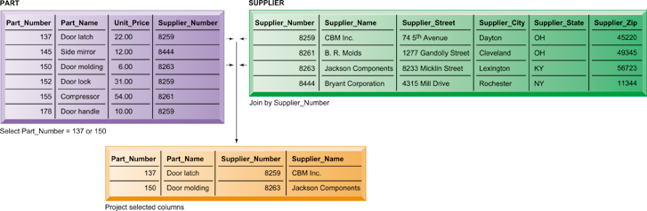
Essentials of Management Information Systems
Chapter 6 Foundations of Business Intelligence: Databases and
Information Management
What are the principles of a database management system?
The Three Basic Operations of a Relational DBMS
Figure 5-8
Figure 6.9
The select, project, and join operations enable data from two different tables to be combined and only selected attributes to be displayed.
Notes:
This graphic illustrates the result from combining the select, join, and project operations to create a subset of data. The SELECT operation retrieves just those parts in the PART table whose part number is 137 or 150. The JOIN operation uses the foreign key of the Supplier_Number provided by the PART table to locate supplier data from the Supplier Table for just those records selected in the SELECT operation. Finally, the PROJECT operation limits the columns to be shown to be simply the part number, part name, supplier number, and supplier name (orange rectangle).

Slide 23
Essentials of Management Information Systems
Chapter 6 Foundations of Business Intelligence: Databases and
Information Management
What are the principles of a database management system?
Capabilities of Database Management Systems
Data definition capabilities:
  Specify structure of content of database.
Data dictionary:
  Automated or manual file storing definitions of data elements and their characteristics.
Querying and reporting:
  Data manipulation language
    Structured query language (SQL)
    Microsoft Access query-building tools
  Report generation, e.g., Crystal Reports
Notes:
One important function of databases is to bring about common definitions of entities and attributes, like what is a fiscal year, how to express date of hire, and defining “business location.” In pre-database environments, and even in global companies, these definitions vary from one location to another.

Slide 24
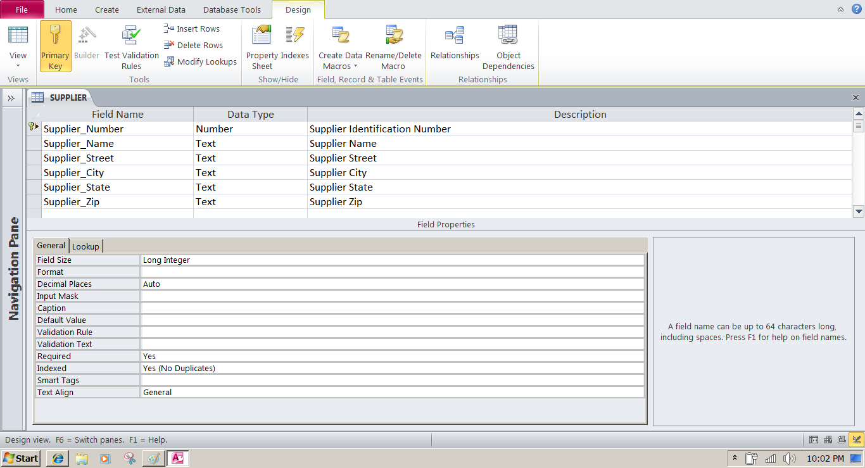
Essentials of Management Information Systems
Chapter 6 Foundations of Business Intelligence: Databases and
Information Management
What are the principles of a database management system?
Access Data Dictionary Features
Microsoft Access has a rudimentary data dictionary capability that displays information about the size, format, and other characteristics of each field in a database. Displayed here is the information maintained in the SUPPLIER table. The small key icon to the left of Supplier_Number indicates that it is a key field.
Figure 6.10
Notes:
This graphic shows the data dictionary capability of Microsoft Access. For the field “Supplier Name” selected in the top pane, definitions can be configured in the General tab in the bottom pane. These General characteristics are Fields Size, Format, Input Mask, Caption, Default Value, Validation Rule, Validation Text, Required, Allow Zero Length, Indexed, Unicode Compression, IME mode, IME Sentence Mode, and Smart Tags.

Slide 25
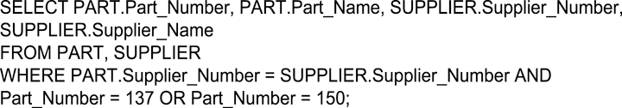
Essentials of Management Information Systems
Chapter 6 Foundations of Business Intelligence: Databases and
Information Management
What are the principles of a database management system?
Example of an SQL Query
Illustrated here are the SQL statements for a query to select suppliers for parts 137 or 150. They produce a list with the same results as Figure 6.9.
Figure 6.11
Notes:
This graphic shows an example SQL statement that would be used to retrieve data from a database. In this case, the SQL statement is retrieving records from the PART table illustrated on Slide 20 (Figure 6-8) whose Part Number is either 137 or 150.
Ask students to relate what each phrase of this statement is doing. (For example, the statement says to take the following columns: Part_Number, Part_Name, Supplier Number, Supplier Name, from the two tables Part and Supplier, when the following two conditions are true…)

Slide 26
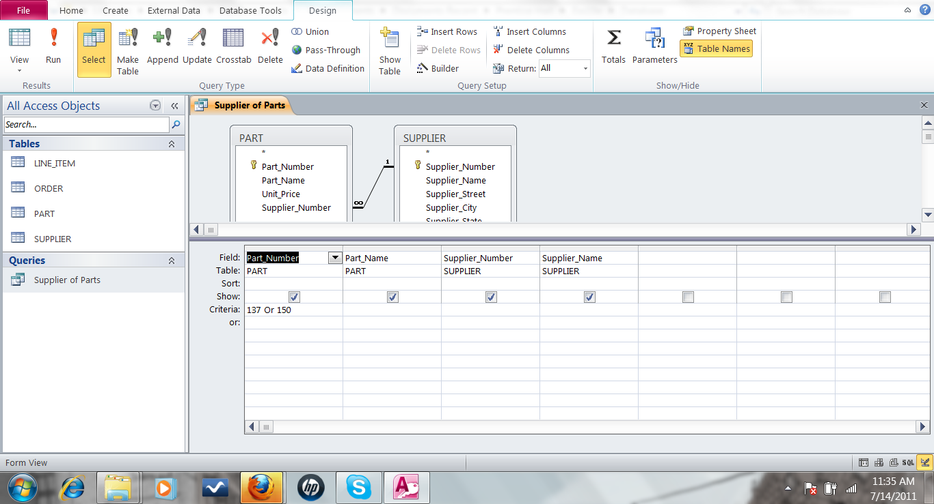
Essentials of Management Information Systems
Chapter 6 Foundations of Business Intelligence: Databases and
Information Management
What are the principles of a database management system?
An Access Query
Illustrated here is how the query in Figure 6-10 would be constructed using Microsoft Access query-building tools. It shows the tables, fields, and selection criteria used for the query.
Figure 6.12
Notes:
This graphic illustrates a Microsoft Access query that performs the same operation as the SQL query in the last slide. The query pane at the bottom shows the fields that are requested (Fields), the relevant Tables (Table), the fields that will be displayed in the results (Show), and the criteria limiting the results to Part numbers 137 and 150 (Criteria).

Slide 27
Essentials of Management Information Systems
Chapter 6 Foundations of Business Intelligence: Databases and
Information Management
What are the principles of a database management system?
Non-Relational Databases
Developed to handle large data sets of data that is not easily organized into tables, columns, and rows
“NoSQL”: Non-relational database technologies
Non-relational DBMS
  Use more flexible data model
  Don’t require extensive structuring
  Can manage unstructured data, such as social media and graphics
  E.g. Amazon’s SimpleDB

Slide 28
Essentials of Management Information Systems
Chapter 6 Foundations of Business Intelligence: Databases and
Information Management
What are the principles of a database management system?
Cloud Databases
Relational database engines provided by cloud computing services, such as Amazon
Pricing based on usage
Appeal to Web-focused businesses, small or medium-sized businesses seeking lower costs than developing and hosting in-house databases
E.g. Amazon Relational Database Service
  Offers MySQL, Microsoft SQL Server, Oracle Database engines
Private clouds

Slide 29
Essentials of Management Information Systems
Chapter 6 Foundations of Business Intelligence: Databases and
Information Management
Using Databases to Improve Business Performance and Decision Making
The Challenge of Big Data
Massive quantities of unstructured and semi-structured data from Internet and networked services and applications
Big datasets provide opportunity more patterns and insights than smaller datasets, e.g.
  Customer behavior
  Weather patterns
Requires new technologies and tools

Slide 30
Essentials of Management Information Systems
Chapter 6 Foundations of Business Intelligence: Databases and
Information Management
Using Databases to Improve Business Performance and Decision Making
Business Intelligence Infrastructure
Array of tools for obtaining useful information from internal and external systems and big data
  Data warehouses
  Data marts
  Hadoop
  In-memory computing
  Analytical platforms
Notes:
Modern databases can store enormous amounts of information. Consider that PhotoBucket has 80 billion photos on tap! Yet making sense out of all this data is a challenge for managers. What’s needed are tools to organize the data, analyze, and describe what’s happening in the real world based on the data.

Slide 31
Essentials of Management Information Systems
Chapter 6 Foundations of Business Intelligence: Databases and
Information Management
Using Databases to Improve Business Performance and Decision Making
Data Warehouses
Data warehouse:
  Database that stores current and historical data that may be of interest to decision makers
  Consolidates and standardizes data from many systems, operational and transactional databases
  Data can be accessed but not altered
Data mart:
  Subset of data warehouses that is highly focused and isolated for a specific population of users
Notes:
Data warehouses and data marts are two tools that bring data together and move it offline to storage areas where it can be analyzed without interfering with the transaction processing systems that produce the data. Data analysis, business intelligence applications, would slow down transaction processing.

Slide 32
Essentials of Management Information Systems
Chapter 6 Foundations of Business Intelligence: Databases and
Information Management
Using Databases to Improve Business Performance and Decision Making
Hadoop
Open-source software framework from Apache
Designed for big data
Breaks data task into sub-problems and distributes the processing to many inexpensive computer processing nodes
Combines result into smaller data set that is easier to analyze
Key services
  Hadoop Distributed File System (HDFS)
  MapReduce

Slide 33
Essentials of Management Information Systems
Chapter 6 Foundations of Business Intelligence: Databases and
Information Management
Using Databases to Improve Business Performance and Decision Making
In-Memory Computing
Relies on computer’s main memory (RAM) for data storage
Eliminates bottlenecks in retrieving and reading data from hard-disk based databases
Dramatically shortens query response times
Enabled by
  High-speed processors
  Multicore processing
  Falling computer memory prices
Lowers processing costs

Slide 34
Essentials of Management Information Systems
Chapter 6 Foundations of Business Intelligence: Databases and
Information Management
Using Databases to Improve Business Performance and Decision Making
Analytic Platforms
Preconfigured hardware-software systems
Designed for query processing and analytics
Use both relational and non-relational technology to analyze large data sets
Include in-memory systems, NoSQL DBMS
E.g. IBM Netezza
  Integrated database, server, storage components

Slide 35
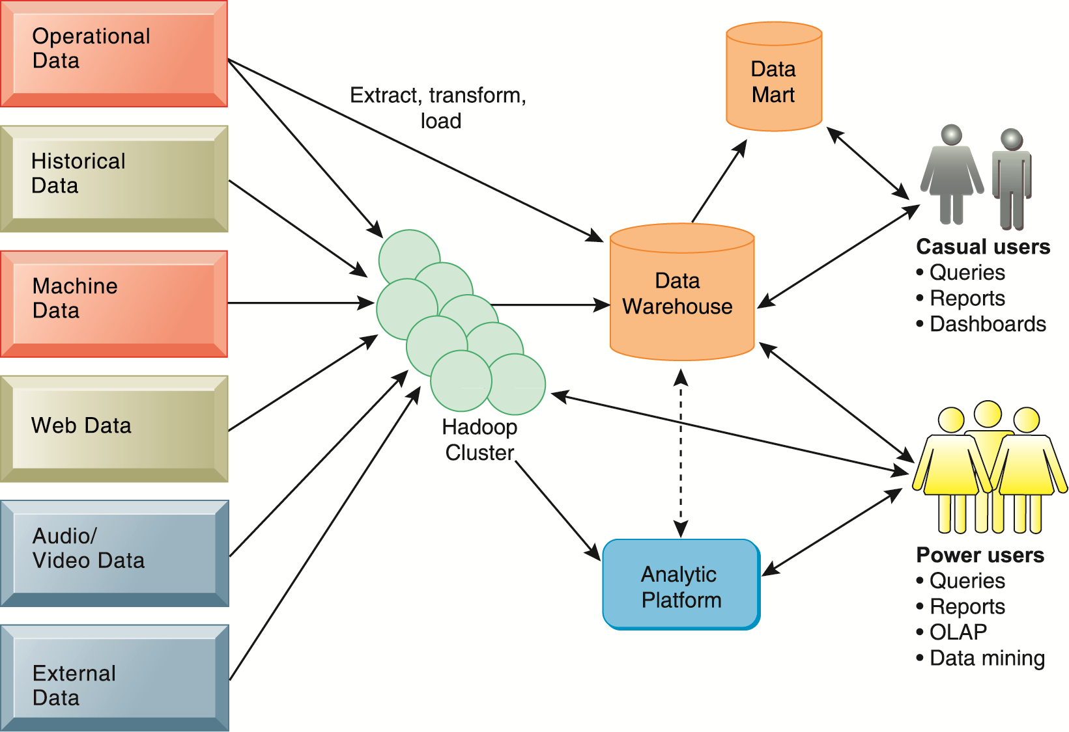
Essentials of Management Information Systems
Chapter 6 Foundations of Business Intelligence: Databases and
Information Management
Using Databases to Improve Business Performance and Decision Making
Contemporary Business Intelligence Infrastructure
A contemporary business intelligence infrastructure features capabilities and tools to manage and analyze large quantities and different types of data from multiple sources. Easy-to-use query and reporting tools for casual business users and more sophisticated analytical toolsets for power users are included.
Figure 6-13

Slide 36
Essentials of Management Information Systems
Chapter 6 Foundations of Business Intelligence: Databases and
Information Management
Using Databases to Improve Business Performance and Decision Making
Analytical Tools: Relationships, Patterns, Trends
Once data gathered, tools are required for consolidating, analyzing, and insight to improve decision making
  Software for database querying and reporting
  Multidimensional data analysis (OLAP)
  Data mining

Slide 37
Essentials of Management Information Systems
Chapter 6 Foundations of Business Intelligence: Databases and
Information Management
Using Databases to Improve Business Performance and Decision Making
Online Analytical Processing (OLAP)
Supports multidimensional data analysis, enabling users to view the same data in different ways using multiple dimensions
  Each aspect of information—product, pricing, cost, region, or time period—represents a different dimension
  E.g., comparing sales in East in June versus May and July
Enables users to obtain online answers to ad hoc questions such as these in a fairly rapid amount of time

Slide 38
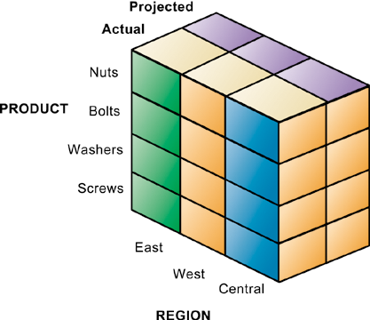
Essentials of Management Information Systems
Chapter 6 Foundations of Business Intelligence: Databases and
Information Management
Using Databases to Improve Business Performance and Decision Making
Multidimensional Data Model
The view that is showing is product versus region. If you rotate the cube 90 degrees, the face that will show is product versus actual and projected sales. If you rotate the cube 90 degrees again, you will see region versus actual and projected sales. Other views are possible.
Figure 6.14
Notes:
This graphic illustrates a data cube composed of three dimensions: actual/projected sales, product, and region. Obviously, the point is to try and understand differences between actual and projected sales by looking at region and product. This is an ideal problem for pivot tables in Excel because two of the variables are categorical (product and region), one is interval.

Slide 39
Essentials of Management Information Systems
Chapter 6 Foundations of Business Intelligence: Databases and
Information Management
Using Databases to Improve Business Performance and Decision Making
Data Mining
Finds hidden patterns and relationships in large databases and infers rules from them to predict future behavior
Types of information obtainable from data mining
  Associations: occurrences linked to single event
  Sequences: events linked over time
  Classifications: patterns describing a group an item belongs to
  Clustering: discovering as yet unclassified groupings
  Forecasting: uses series of values to forecast future values
Notes:
With terrorism so much in the news, you might ask students how they imagine federal officials use data mining to identify potential or actual terrorists. For instance, if one was looking for terrorists, what kinds of associations, sequences, classifications, and clusters would you look for.

Slide 40
Essentials of Management Information Systems
Chapter 6 Foundations of Business Intelligence: Databases and
Information Management
Using Databases to Improve Business Performance and Decision Making
Interactive Session: People
American Water Keeps Data Flowing
Read the Interactive Session and then discuss the following questions:
Discuss the role of information policy, data administration, and efforts to ensure data quality in improving data management at American Water.
Describe roles played by information systems specialists and end users in American Water’s systems transformation project.
Why was the participation of business users so important? If they didn’t play this role, what would have happened?
How did implementing a data warehouse help American Water moved toward a more centralized organization?
Give some examples of problems that would have occurred at American Water if its data were not “clean”?
How would American Water’s data warehouse improve operations and management decision making?
Notes:
Firms today are collecting thousands of gigabytes of data simply by tracking all the consumers that visit their stores or locations. By analyzing their customer data, firms can obtain a much better and in-depth understanding of their customers.

Slide 41
Essentials of Management Information Systems
Chapter 6 Foundations of Business Intelligence: Databases and
Information Management
Using Databases to Improve Business Performance and Decision Making
Text Mining
  Unstructured data (mostly text files) accounts for 80 percent of an organization’s useful information.
  Text mining allows businesses to extract key elements from, discover patterns in, and summarize large unstructured data sets.
  Sentiment analysis
    Mines online text comments online or in e-mail to measure customer sentiment

Slide 42
Essentials of Management Information Systems
Chapter 6 Foundations of Business Intelligence: Databases and
Information Management
Using Databases to Improve Business Performance and Decision Making
Web Mining
  Discovery and analysis of useful patterns and information from the Web
    E.g. to understand customer behavior, evaluate Web site, quantify success of marketing
  Content mining – mines content of Web sites
  Structure mining – mines Web site structural elements, such as links
  Usage mining – mines user interaction data gathered by Web servers

Slide 43
Essentials of Management Information Systems
Chapter 6 Foundations of Business Intelligence: Databases and
Information Management
Using Databases to Improve Business Performance and Decision Making
Databases and the Web
Firms use the Web to make information from their internal databases available to customers and partners.
Middleware and other software make this possible
  Web server
  Application servers or CGI
  Database server
Web interfaces provide familiarity to users and savings over redesigning legacy systems.

Slide 44
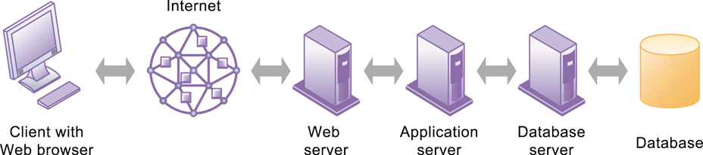
Essentials of Management Information Systems
Chapter 6 Foundations of Business Intelligence: Databases and
Information Management
Using Databases to Improve Business Performance and Decision Making
Linking Internal Databases to the Web
Users access an organization’s internal database through the Web using their desktop PCs and Web browser software.
Figure 6.15
Notes:
This graphic illustrates the way data is passed from a database through to a user with a Web browser. Ask students to describe what types of data transformation occur between the various appliances; for example, what happens to data between the database and the database server?

Slide 45
Essentials of Management Information Systems
Chapter 6 Foundations of Business Intelligence: Databases and
Information Management
Why are information policy, data administration, and data quality assurance essential for managing the firm’s data resources?
Establishing an Information Policy
Information policy
  States organization’s rules for organizing, managing, storing, sharing information
Data administration
  Responsible for specific policies and procedures through which data can be managed as a resource
Database administration
  Database design and management group responsible for defining and organizing the structure and content of the database, and maintaining the database.
Notes:
Databases are much more than hardware and software. Indeed the most difficult parts involve organizational and people considerations. Sometimes the careers of people, and the fate of entire departments, are involved with the data they collect. When you install a DBMS you potentially are changing who collects what information about whom, where, when, and how.

Slide 46
Essentials of Management Information Systems
Chapter 6 Foundations of Business Intelligence: Databases and
Information Management
Managing Data Resources
Ensuring Data Quality
Poor data quality: major obstacle to successful customer relationship management
Data quality problems: caused by
  Redundant and inconsistent data produced by multiple systems
  Data input errors
Data quality audit: structured survey of the accuracy and completeness of data
Data cleansing: detects and corrects incorrect, incomplete, improperly formatted, and redundant data
Notes:
Databases are often collections of dirty data, data that is ambiguous, inaccurate, or incomplete. Before a modern DBMSD system is installed, one large budget item is usually cleaning up the old data in old systems. The size of data quality problems varies from one database to another, but credit record databases usually exhibit a 25 percent rate of quality problems, with 10 percent of the records actually being wrong. Ask students if they are aware of instances where a database was wrong about some person or entity.

Slide 47
Essentials of Management Information Systems
Chapter 6 Foundations of Business Intelligence: Databases and
Information Management
Managing Data Resources
Interactive Session: People
Driving ARI Fleet Management With Real-Time Analytics
Read the Interactive Session and then discuss the following questions:
1. Why was data management so problematic at ARI?
2. Describe ARI’s earlier capabilities for data analysis and reporting and their impact on the business.
3. Was SAP HANA a good solution for ARI? Why or why not?
4. Describe the changes in how ARI and its customers ran their businesses as a result of adopting HANA.
5. Describe two decisions that were improved by
adopting HANA.

